Slide 1
MCCS Social Media
Bi-Weekly Business Update

Slide 2
MCCS Social Media Operations Update
Current Period Highlights:
Fiscal Week | Date Range | Conversations Handled | Responses | Average First Response Time (BH) | Average Response Time (BH) | CSAT Average Score | CSAT Score
Sept Week 3 & 4 | 9/15/19 – 9/28/19 | 3,905 | 4,807 | 55 min | 51 min | 4 | 75%
Oct Week 1 &2 | 9/29/19 – 10/12/19 | 4,018 | 5,199 | 28 min | 42 min | 4.2 | 78%
Business Hours (BH): 9AM – 12AM EST
Conversations Handled – volume of conversations which were handled by an agent over the specified period. If more than one agent handles the same conversation in the period, it is still only counted once. Excludes bulk actions (see Definitions)
Definition of ‘Handled’: An agent has taken an action on a message. Actions include tag, reply, assign, archive, sentiment or note. Bulk actions are excluded from all handling time calculations
Responses – the total number of responses sent during the date range (a two Tweet response would constitute two responses)
Notes:
Lead AFRT & ART were >2 hours

Slide 3
Conversocial Reporting Metrics Defined- CSAT (Customer Satisfaction Score)
CSAT average score (5-point scale) – is calculated by applying a numeric value to a CSAT response
Very Satisfied = 5
Very Unsatisfied = 1
CSAT Score (%) – is the percentage of total survey responses that received a ‘Very satisfied’ or ‘Satisfied’ rating
Current Macy’s CSAT Question:
“How would you rate the service you received from Macy's?”

Slide 4
Customer Satisfaction (CSAT):
Fiscal 2018:
Average CSAT = 4.1
Percent Satisfied = 77%
Fiscal 2019 (YTD):
Average CSAT = 4.1
Percent Satisfied = 78%
 | 2017 | 2018 | 2019
February | Dept. not on Conversocial tool | 64% | 79%
March |  | 79% | 81%
April |  | 77% | 75%
May |  | 78% | 75%
June |  | 84% | 81%
July |  | 80% | 77%
August | Conversocial tool utilized; no survey logic implemented | 85% | 77%
September |  | 71% | 76%
October |  | 74%
November |  | 74%
December |  | 71%
January |  | 78%
Notes:
Current Macy’s Survey Question: How would you rate the service you received from Macy's?
Current BLM Survey Question: How would you rate the service you received from Bloomingdale's?
Conversocial recommended CSAT metric

Slide 5
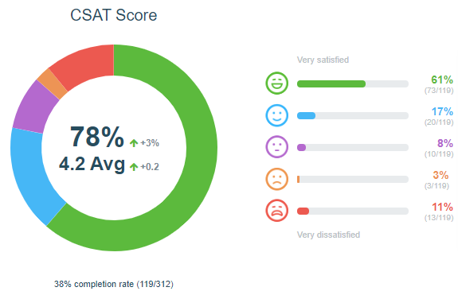
Customer Satisfaction
Date Range: 9/29/19 – 10/12/19
Score: 4.2/5
• 78% of customers selected either “Satisfied” or “Very Satisfied” with Social Media Service
Completion Rate: 38% (119 surveys taken/312 surveys offered)
14% of customers (16/119) selected either “Somewhat Dissatisfied” or “Very Dissatisfied” option
10 customers left comments
Notes:
Point out high take-rate

Slide 6
Somewhat Dissatisfied Summary
Somewhat Dissatisfied Customer Summary (3):
1 Complaint not related to Social Media Service
International order
Customer wanted to cancel order that was in transit
Store complaint
customer was charged twice for order
1 Complaints related to Social Media Service
Customer was issued new card
Our team had an opportunity to help the customer reset password to access acct

Slide 7
Very Dissatisfied Summary
Very Dissatisfied Customers Summary (7):
2 Complaints not related to Social Media Service
3 complaints about phones customer service
Agent processed a return for wrong item
1 complaint about a cancelled order
Customer attempted to cancel an order outside of cancellation time frame. Our team processed a return
1 complaint about product quality
1 Complaints related to Social Media Service
Customer was attempting to buy an item. Our team had opportunity to reach to a quicker resolution

Slide 8
MCOM Chat Update - September
Review current Tableau Chat reporting
Key takeaways:
Dept. improvement in both CP60 and CES scores
Partner Center CP60 Goal = 5.7, Central Score = 5.6
Partner Center CES Goal = 2.25 , Central Score = 2.5
Began weekly MCOM chat meetings. Using takeaways to partner with Terrence & Offshore teams

Slide 9
SM Update Appendix

Slide 10
Macy’s Content Topics
Topic: | Respond:
Positive/Neutral Posts (ICUC owned) | ✓
Site/App Issues | ✓
General Complaints | ✓
Store Issues | ✓
Product Questions (ICUC owned) | ✓
Order Issues | ✓
Racial Profiling | ✓
Fitting Room Issues | ✓
Discrimination | ✓
Threatening Lawsuits | ✓
HR/Employee Complaints | ✓
Celebrity Posts | ✓
Topic: | Respond:
Social Media Trolls | 
Couponing Deals/Spam | 
Trump/Political Posts | 
Fur/PETA | 
Hate Speech | 
Nonsensical Posts | 
Editorial Posts | 
Reviews | 

Slide 11
Priorities for Holiday 2019
Forecast/Staffing
Recommendation for Peak hiring
(Refer to Excel breakdown)
Need for night-shift E-Lead
Backfill night-shift Service Leader
Agent Scorecards
Agent Resources

Slide 12
Close the Loop Items
Aligning internally on next steps following Social Media Working Group session
Updates to Escalation workflow
Better process for channeling feedback to store management teams and quantifying issue-type, location, etc.
GWP inquiries
Working with Pat McHugh & team

